Slide 1
Kinetics of CD4 and CD8 with different vaccine formulation

Slide 2
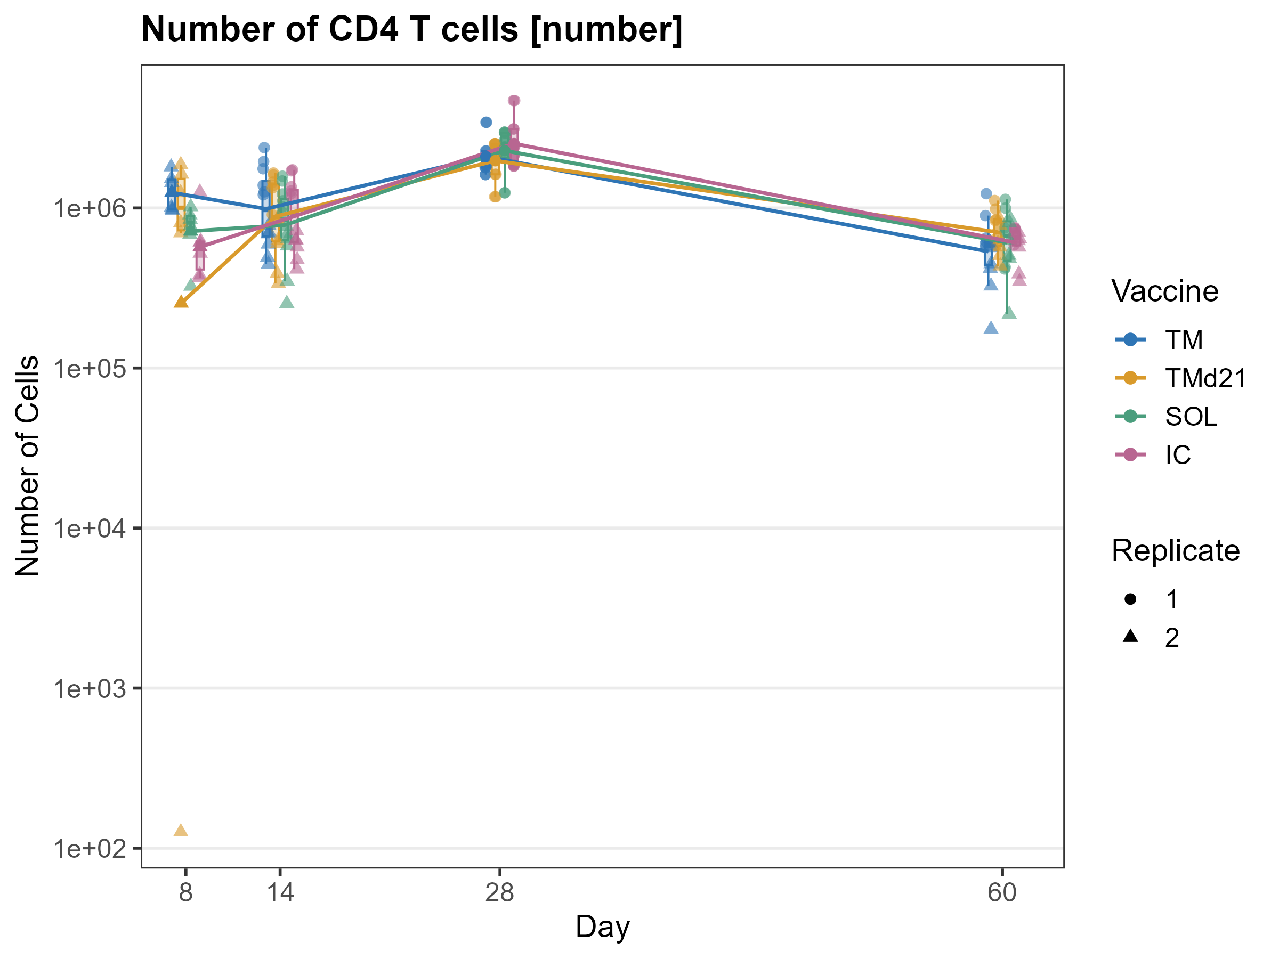








No difference in the total bulk CD4#
Extremely low??
11171

Slide 3
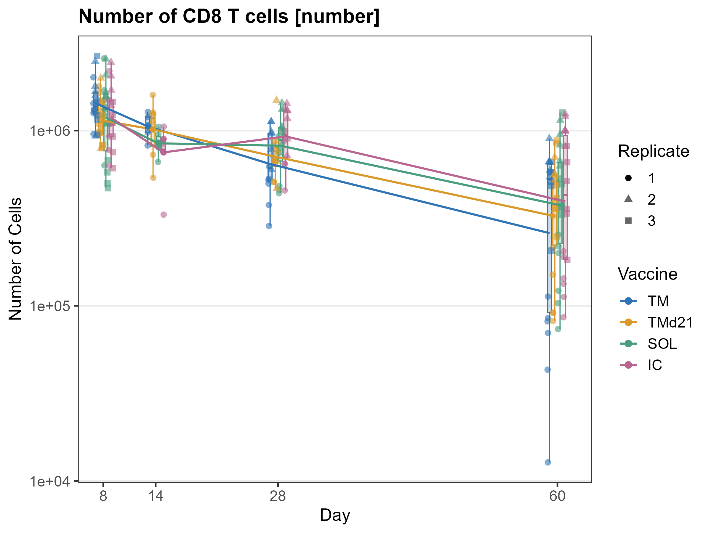
No difference in the total bulk CD8#

Slide 4
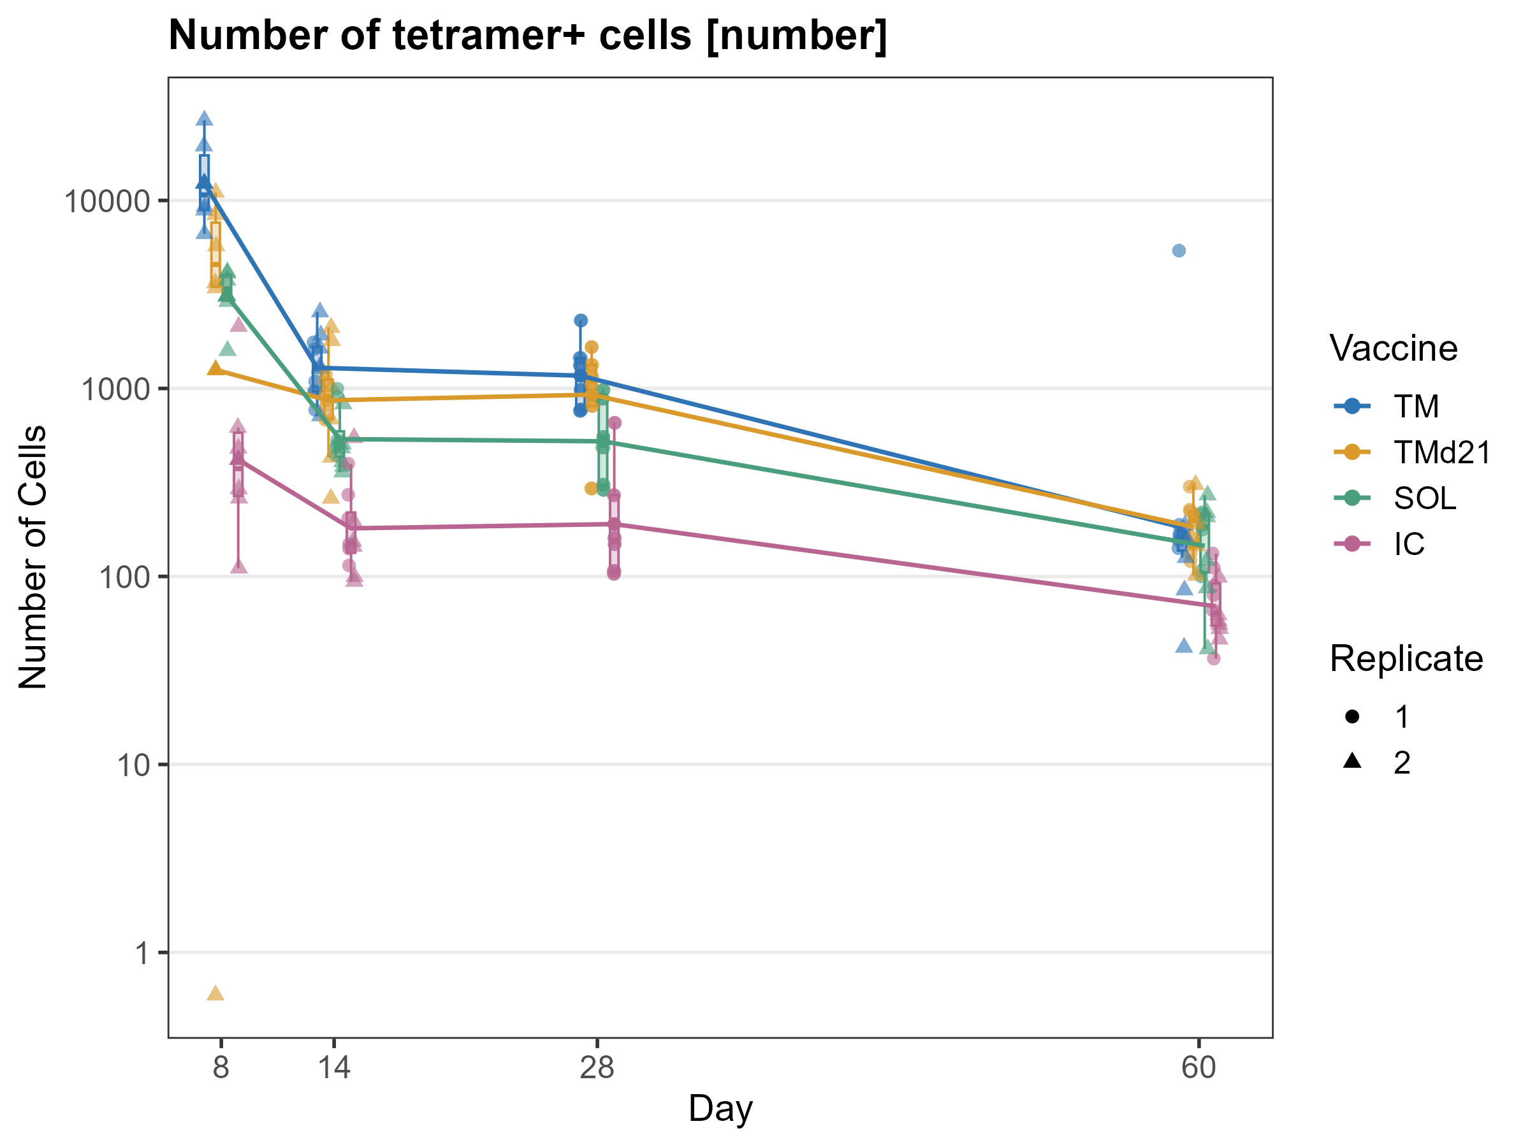
Tetramer+ CD4 T cell
Extremely high??
10236
Extremely low??
11171
TM>TMd21=SOL>IC

Slide 5
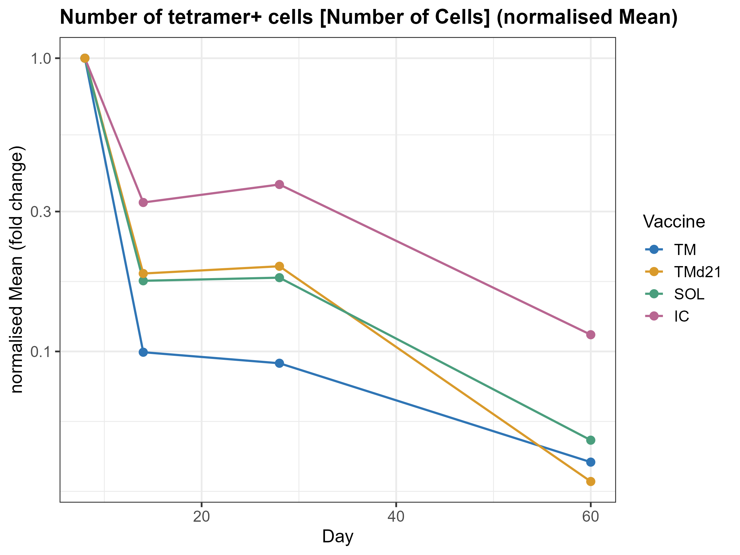
Survival of Tetramer+ CD4 T cell
TM>TMd21=SOL>IC

Slide 6
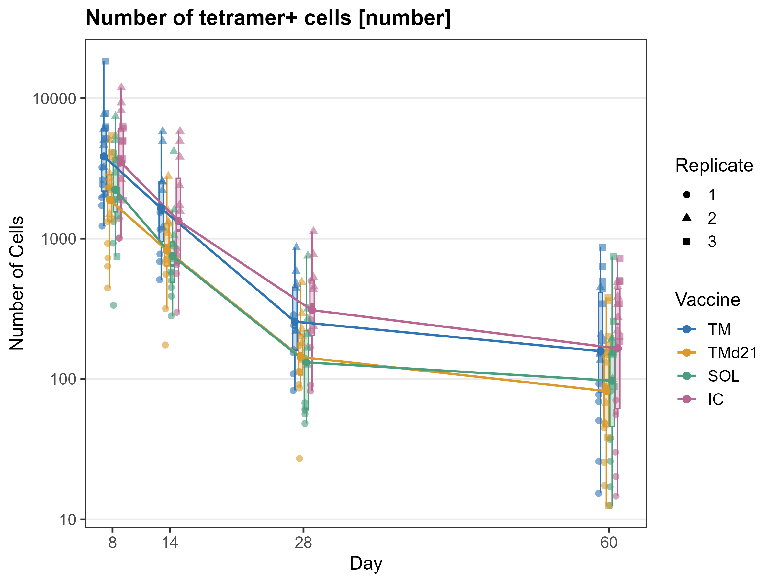
Tetramer+ CD8 T cell
TM> IC >TMd21>SOL

Slide 7
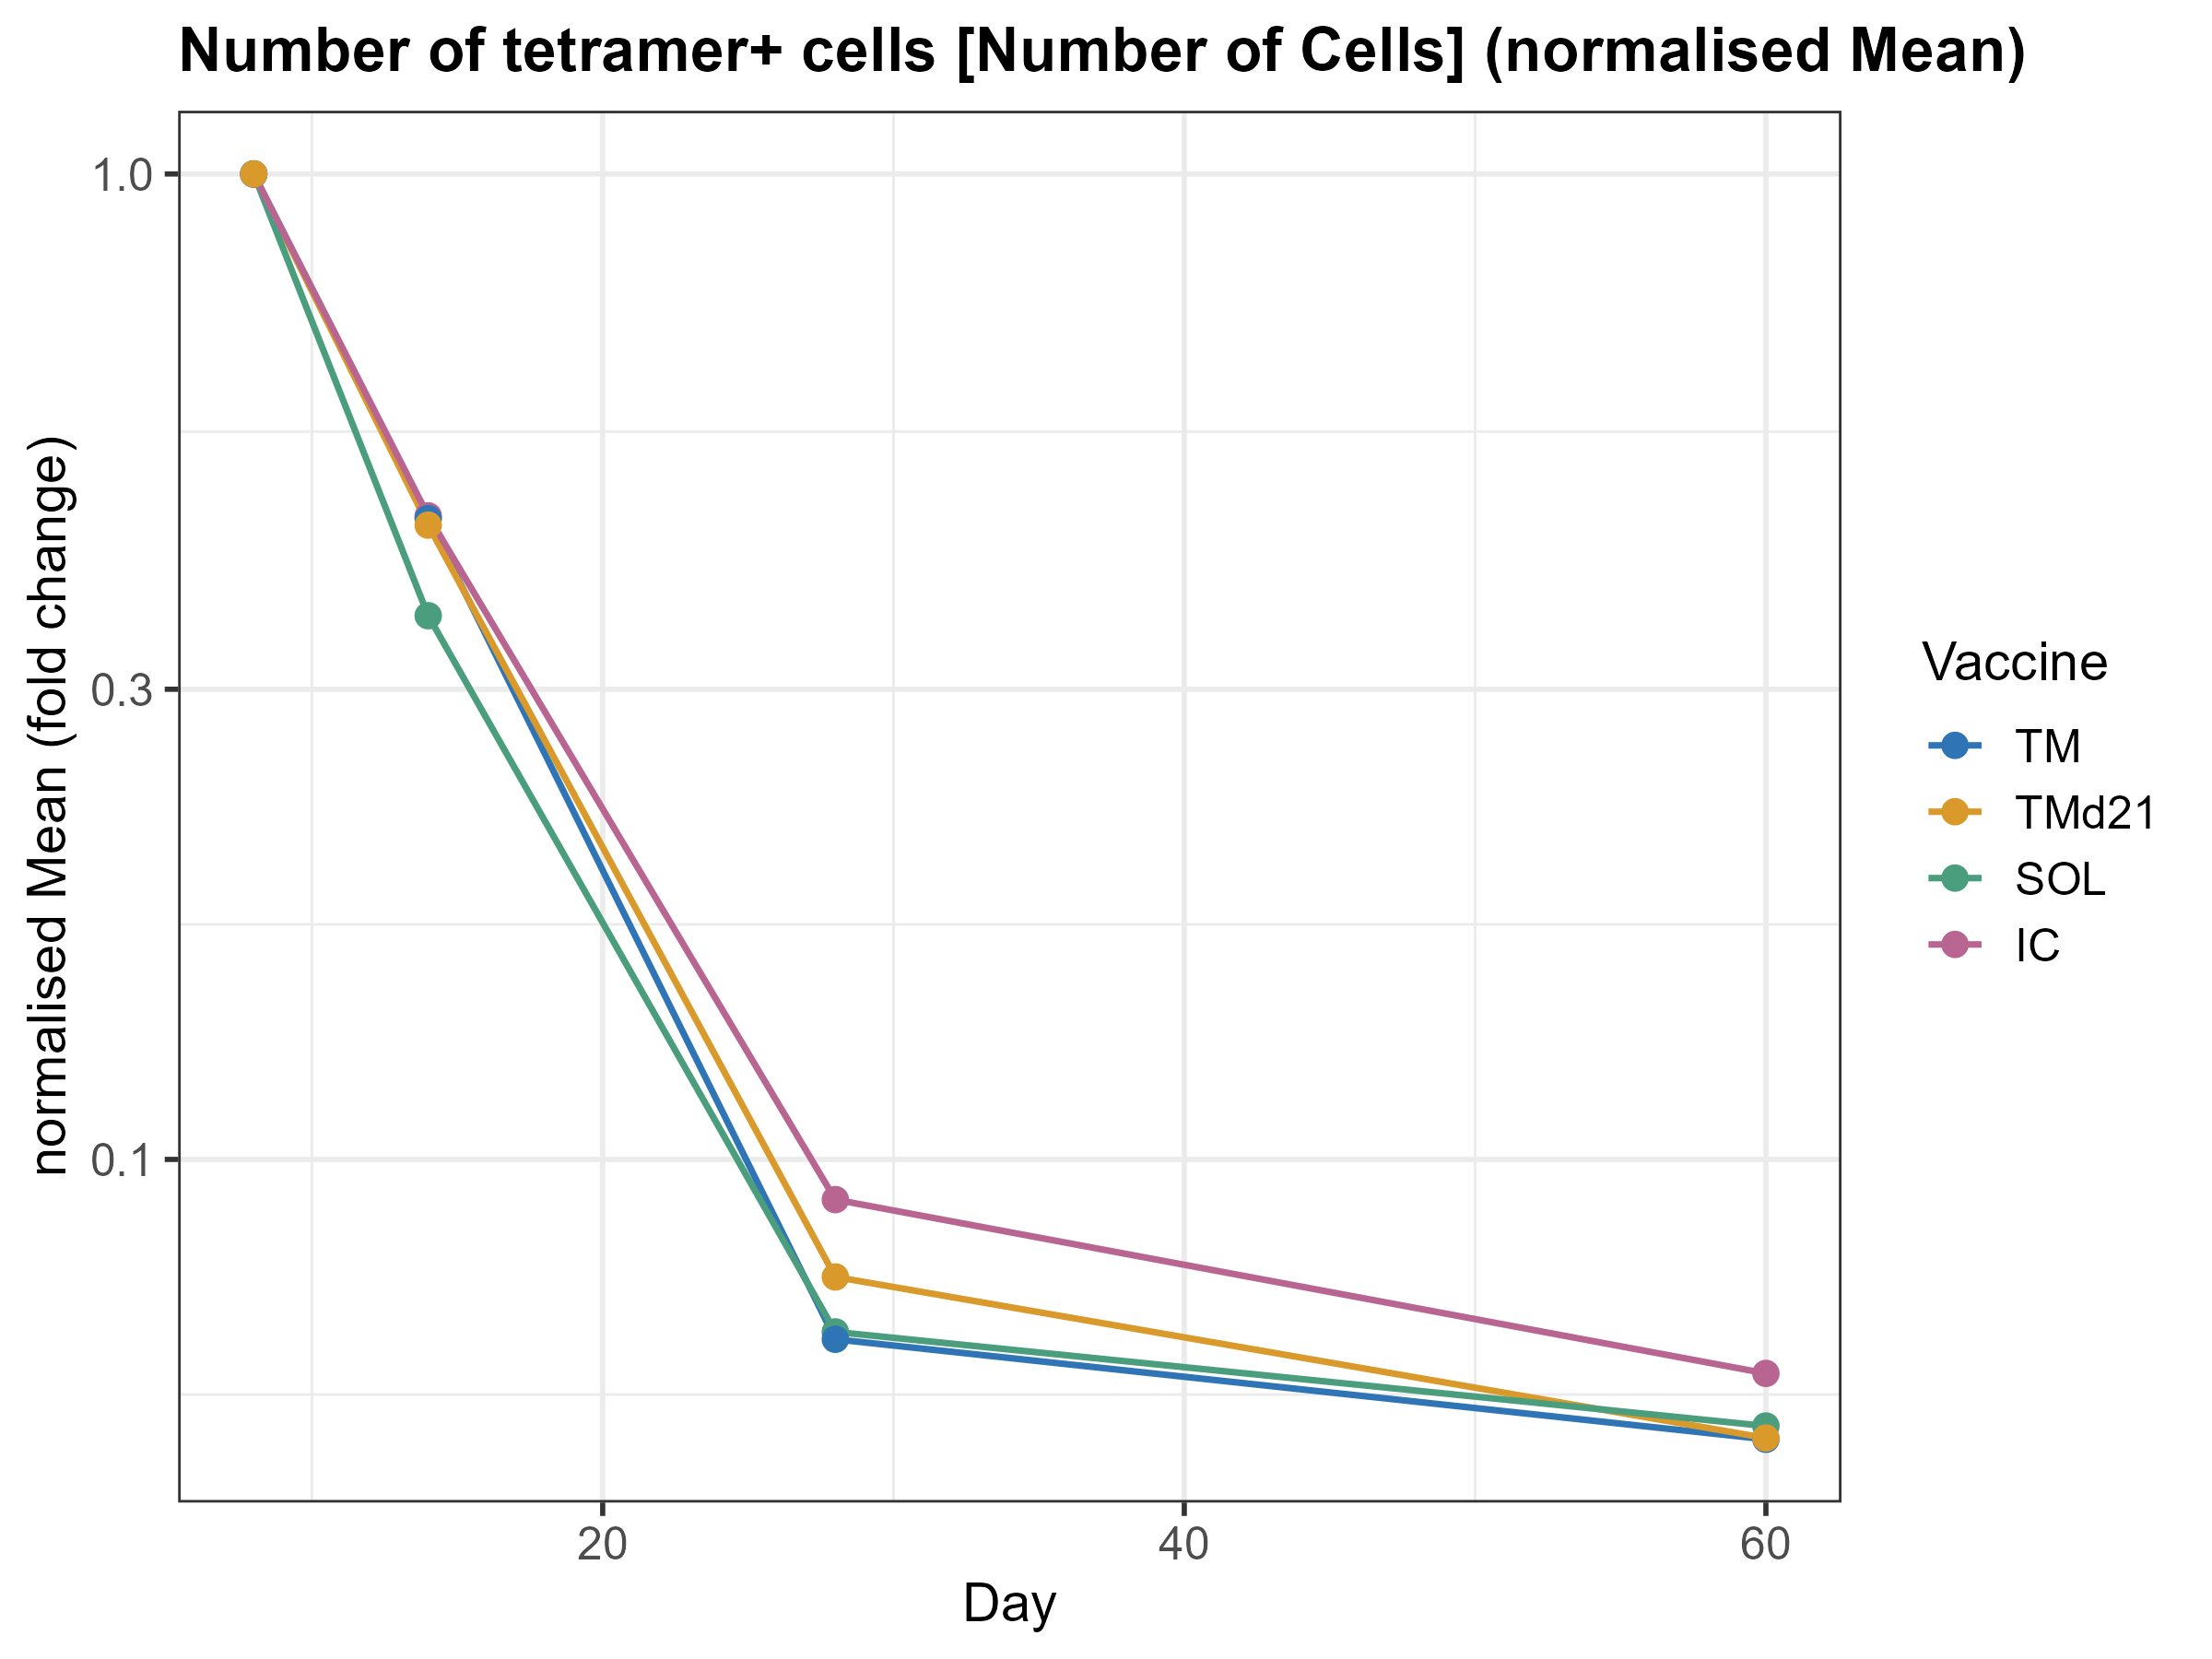
Survival of Tetramer+ CD8 T cell
Similar decay

Slide 8
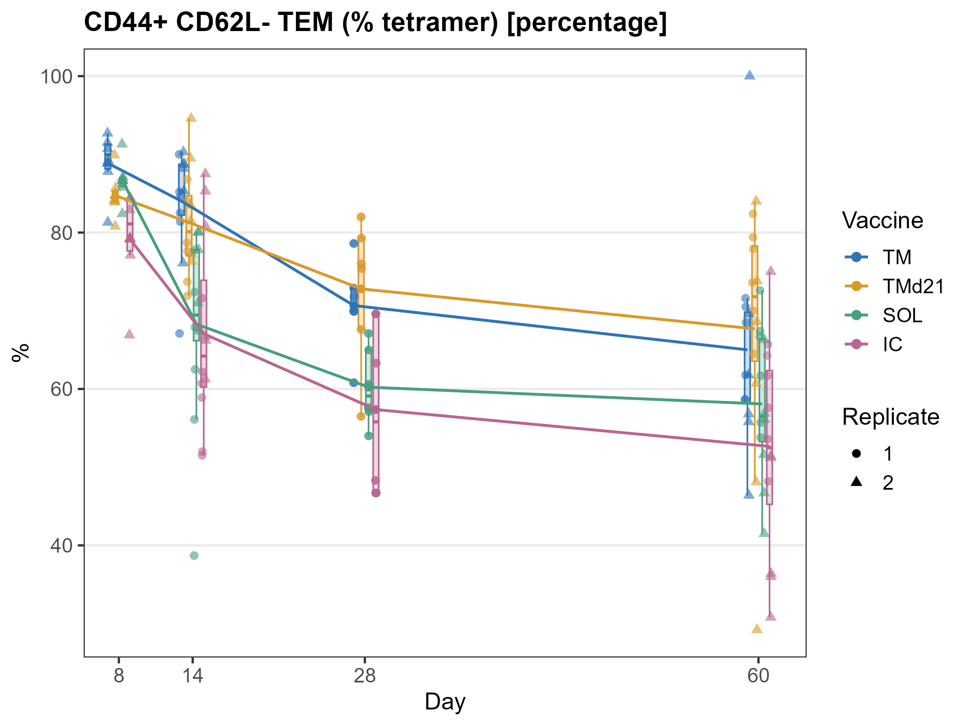
Tet+ CD4 effector phenotype (%)
TM>TMd21>SOL>IC

Slide 9
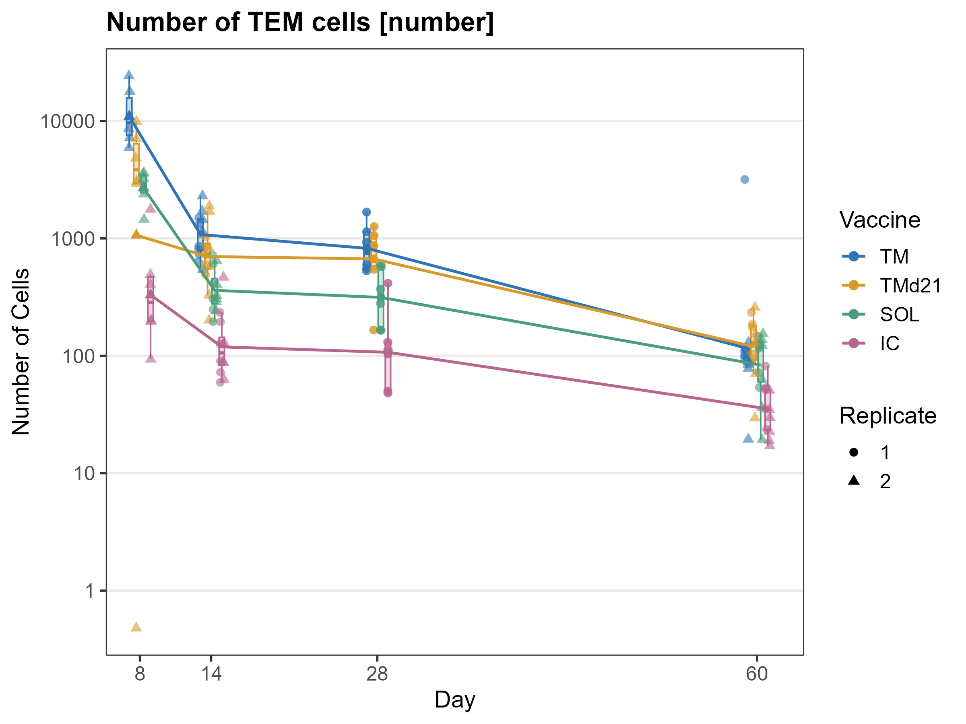
Tet+ CD4 effector cell number
TM>TMd21>SOL>IC

Slide 10
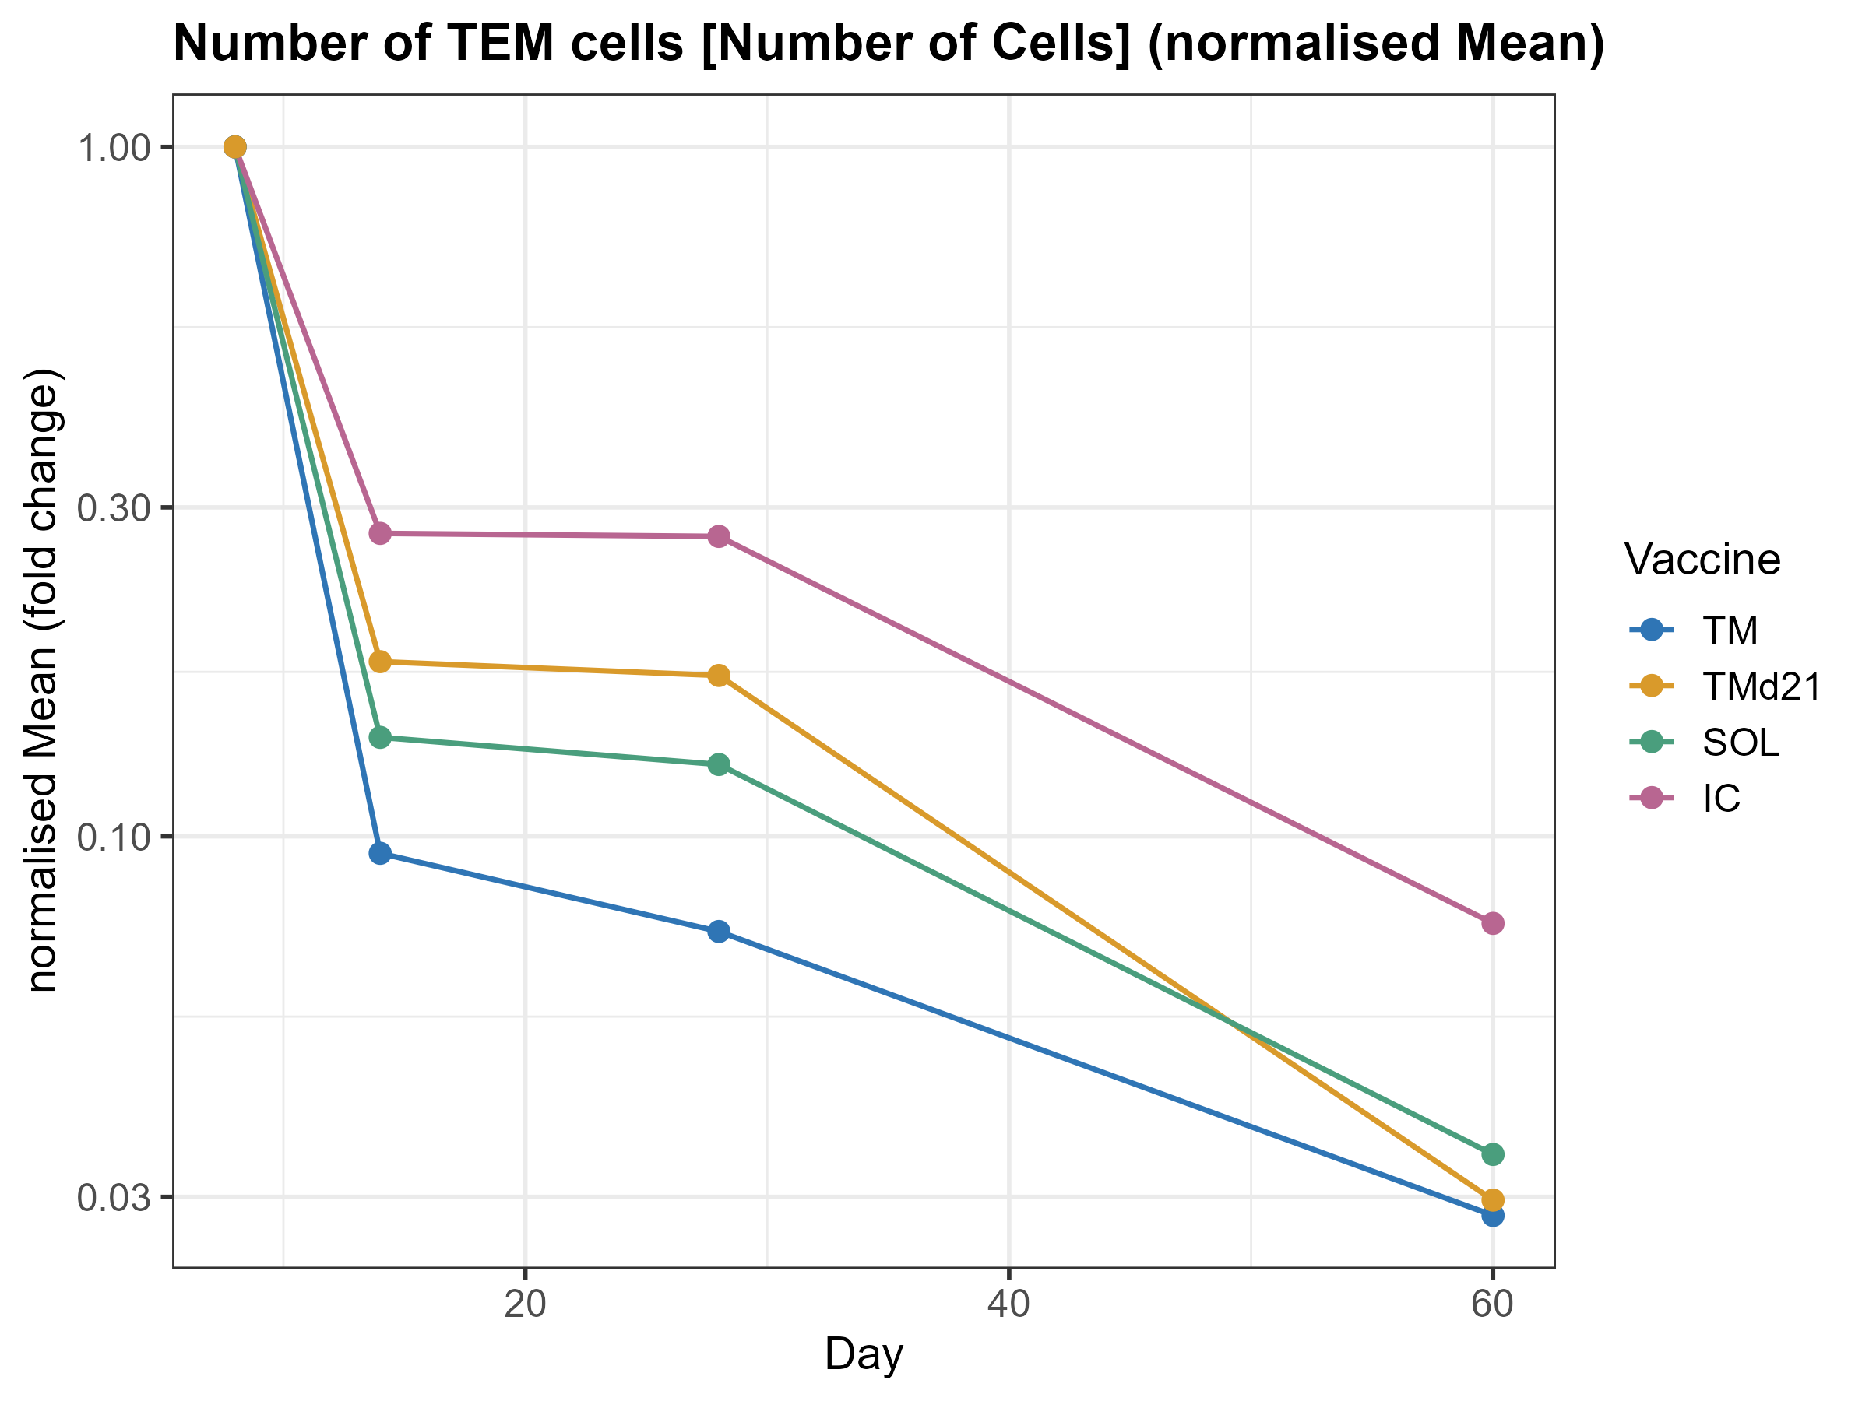
Tet+ CD4 effector survival
TM>SOL>TMd21>IC

Slide 11
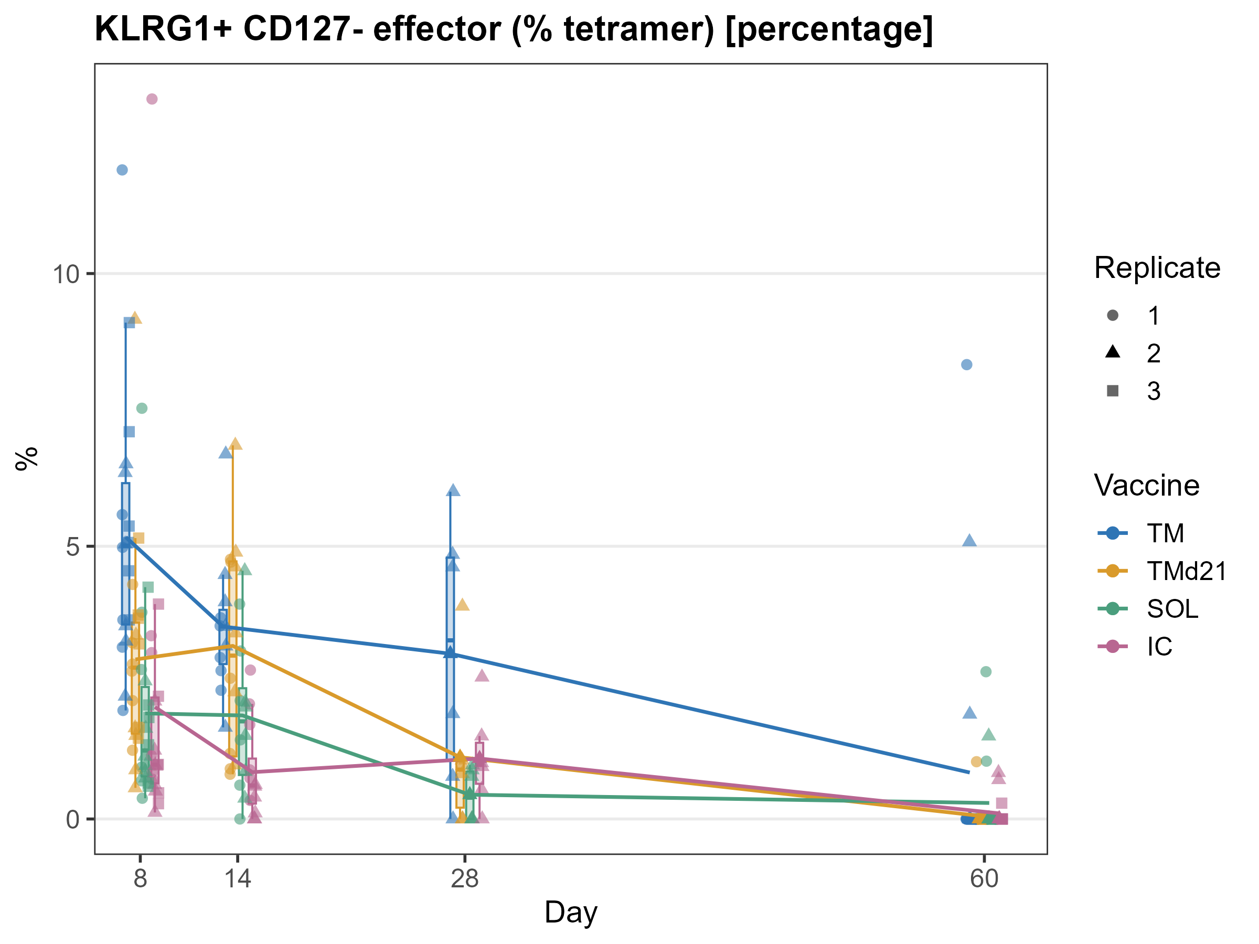
Tet+ CD8 effector phenotype (%)
TM>TMd21>SOL=IC

Slide 12
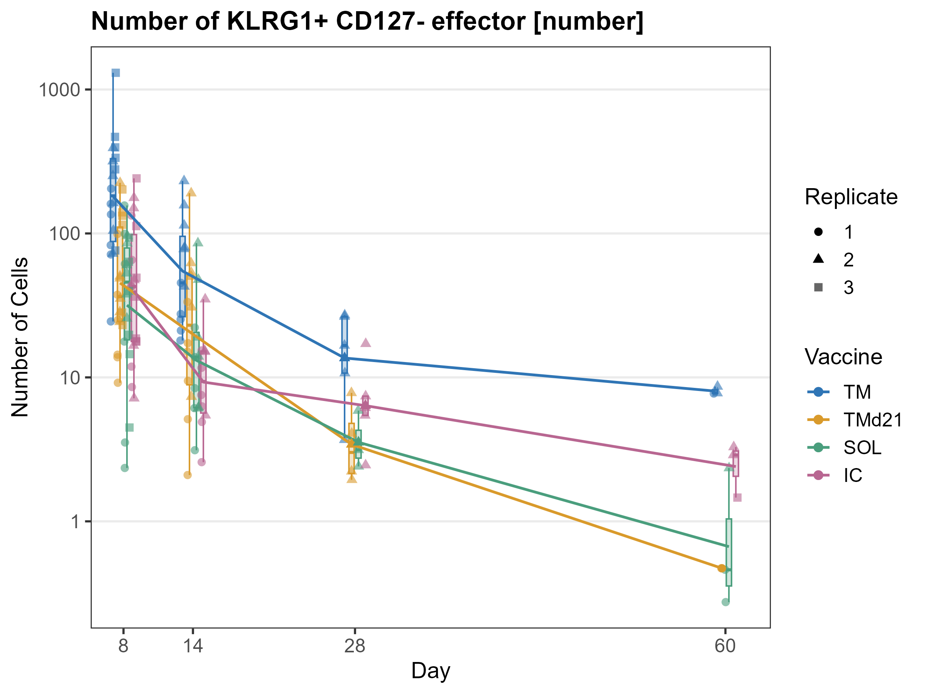
Tet+ CD8 effector cell number
TM>TMd21=SOL=IC

Slide 13
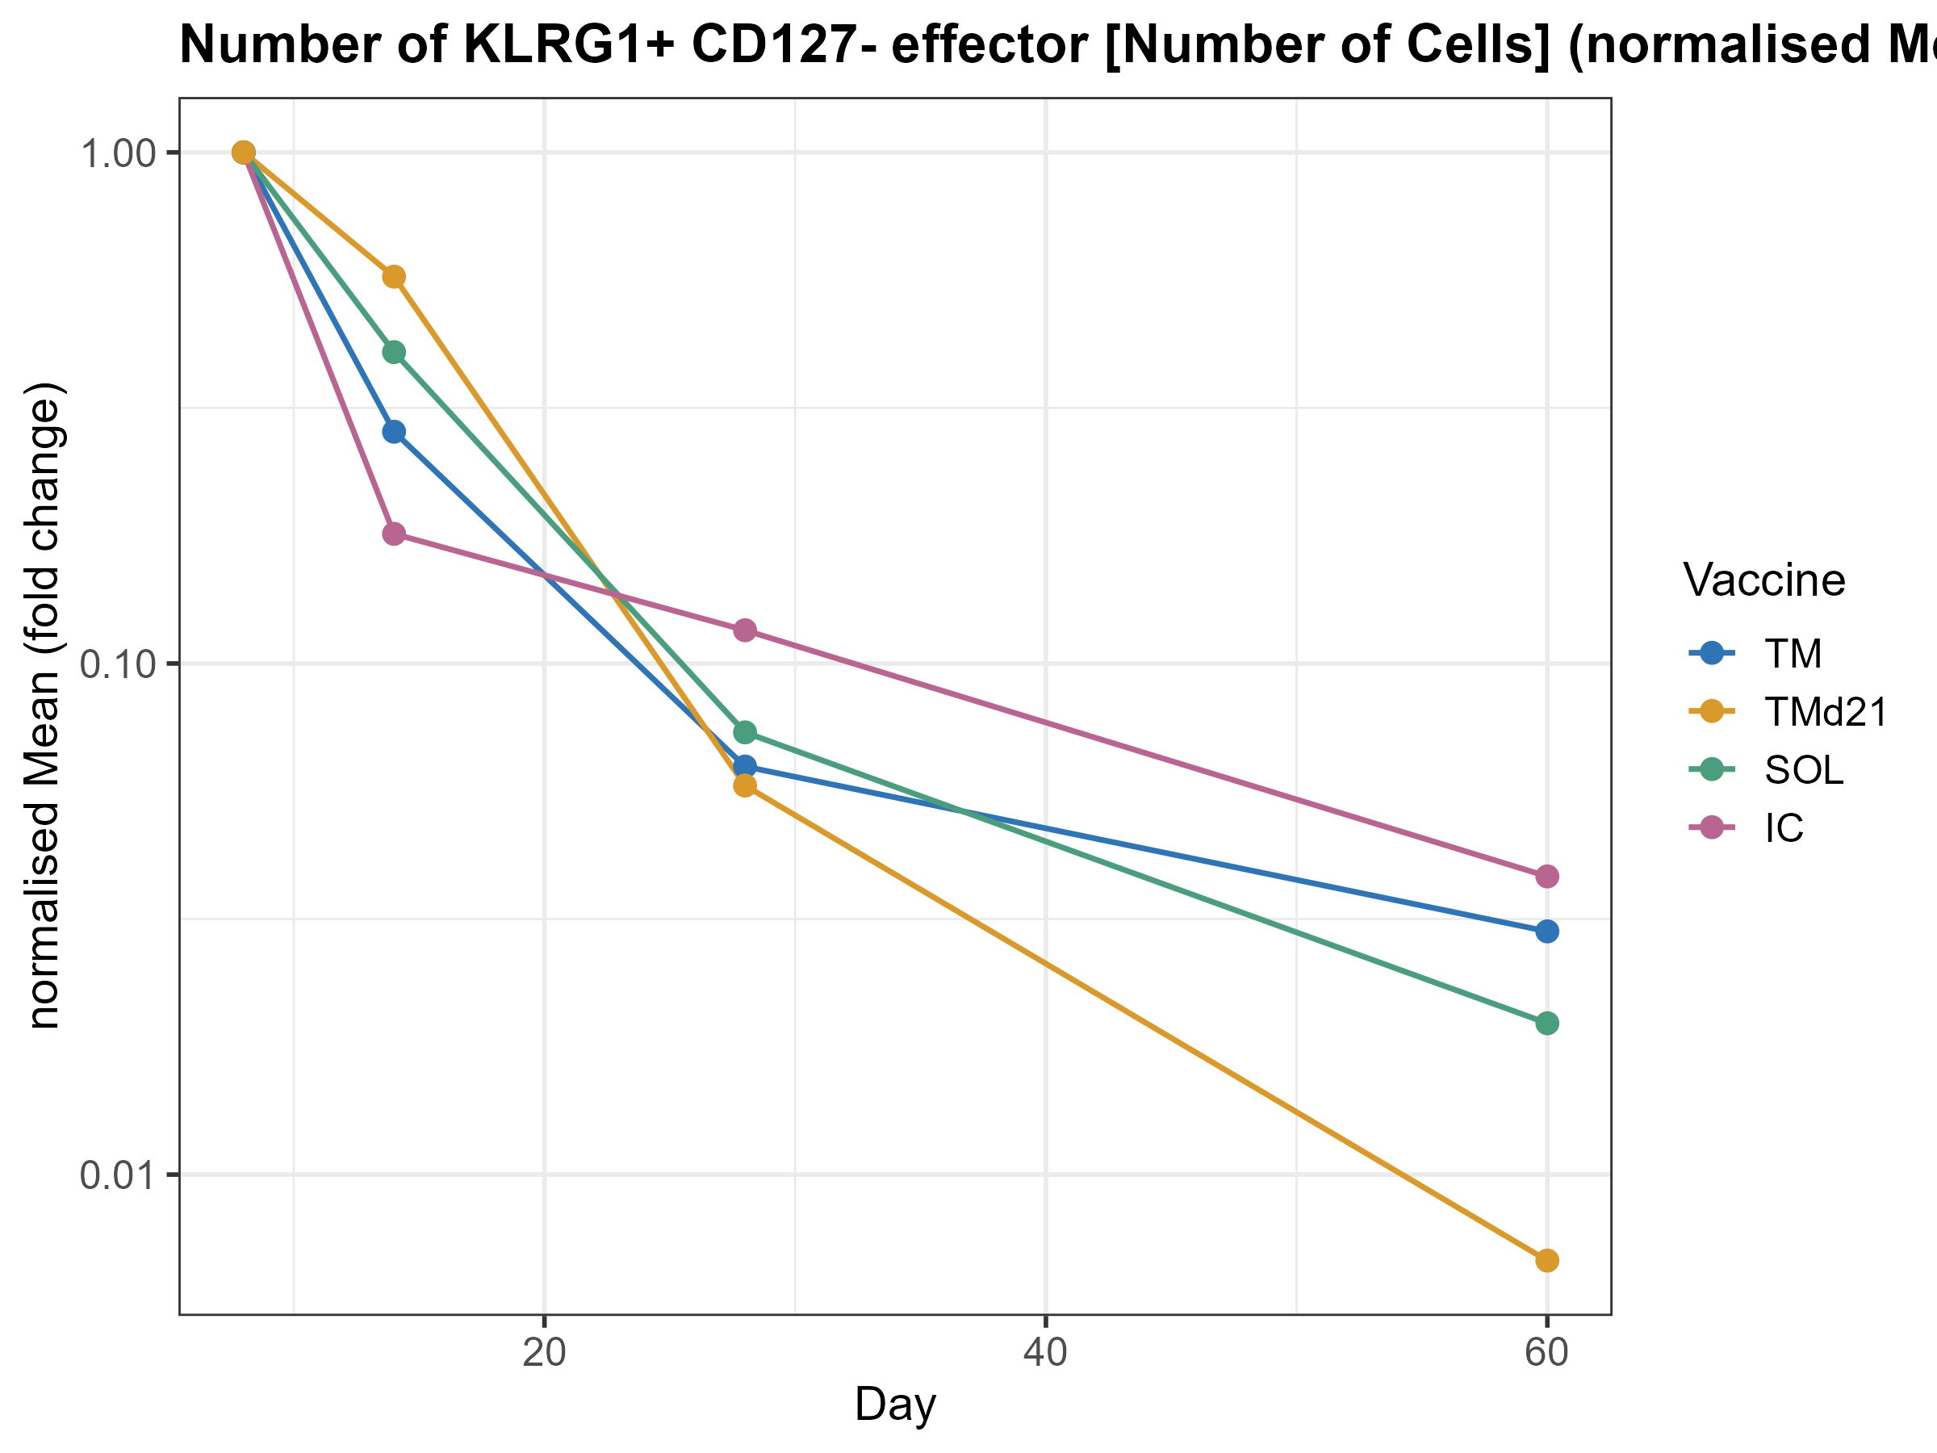
Tet+ CD8 effector survival
similar decay

Slide 14
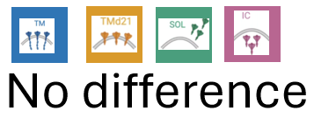
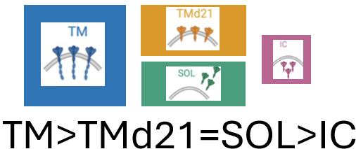
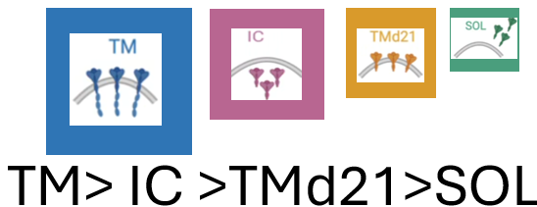

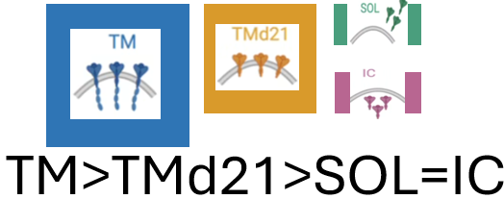


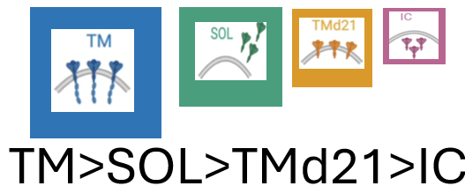
Parameter | CD4 | CD8
Bulk T-cell number
Tetramer⁺ cell number
Tetramer⁺ survival
Effector phenotype (%)
Effector-cell number
Effector-cell survival

